Slide 1
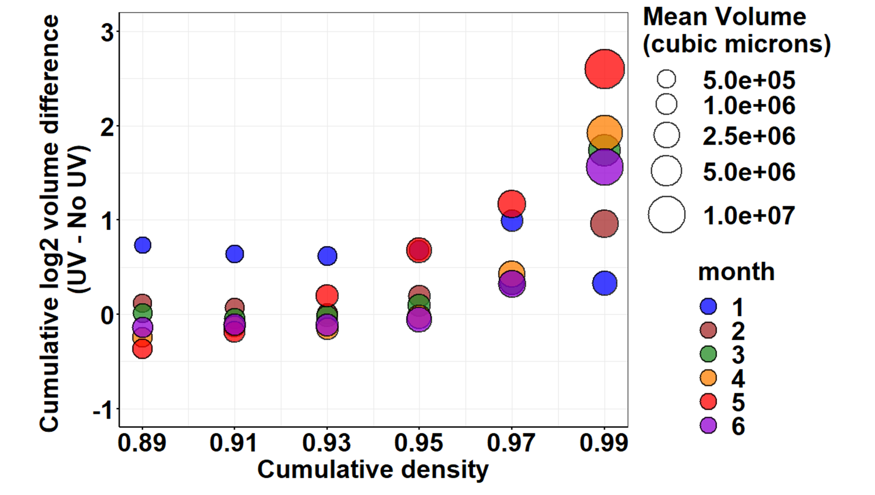

Slide 2
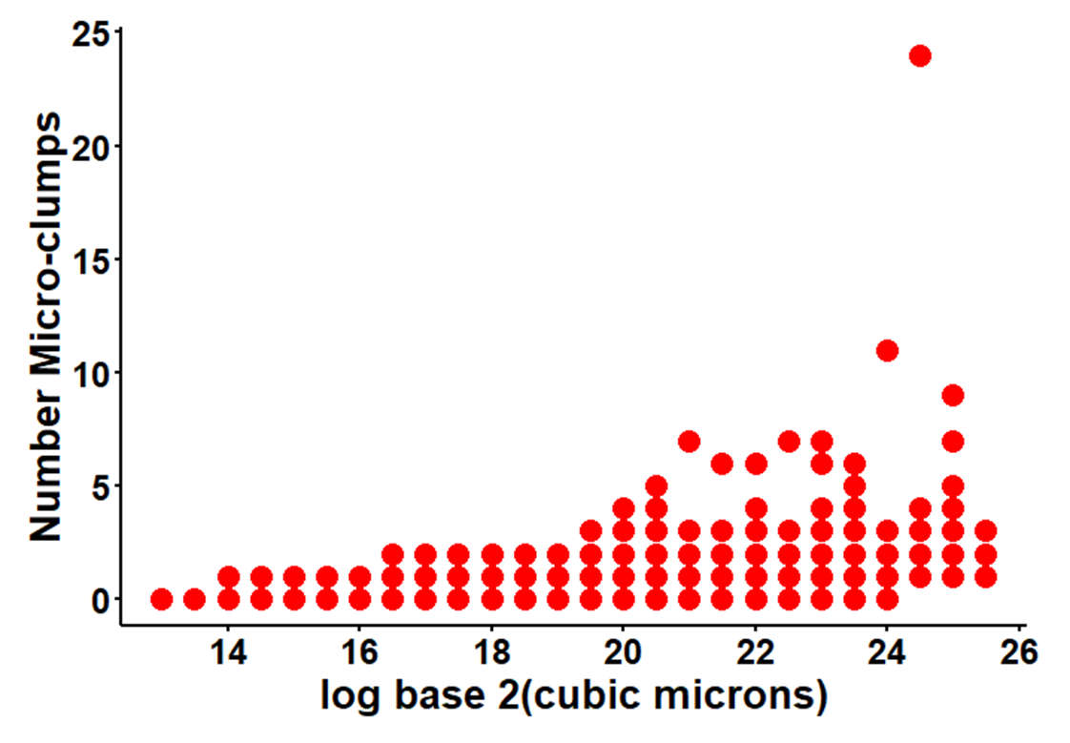
UV-treated

Slide 3
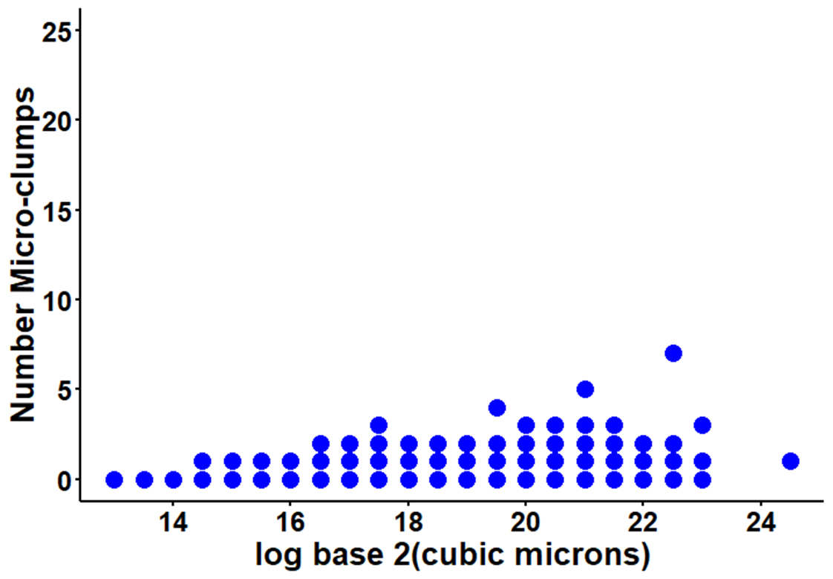
No-UV-treated

Slide 4
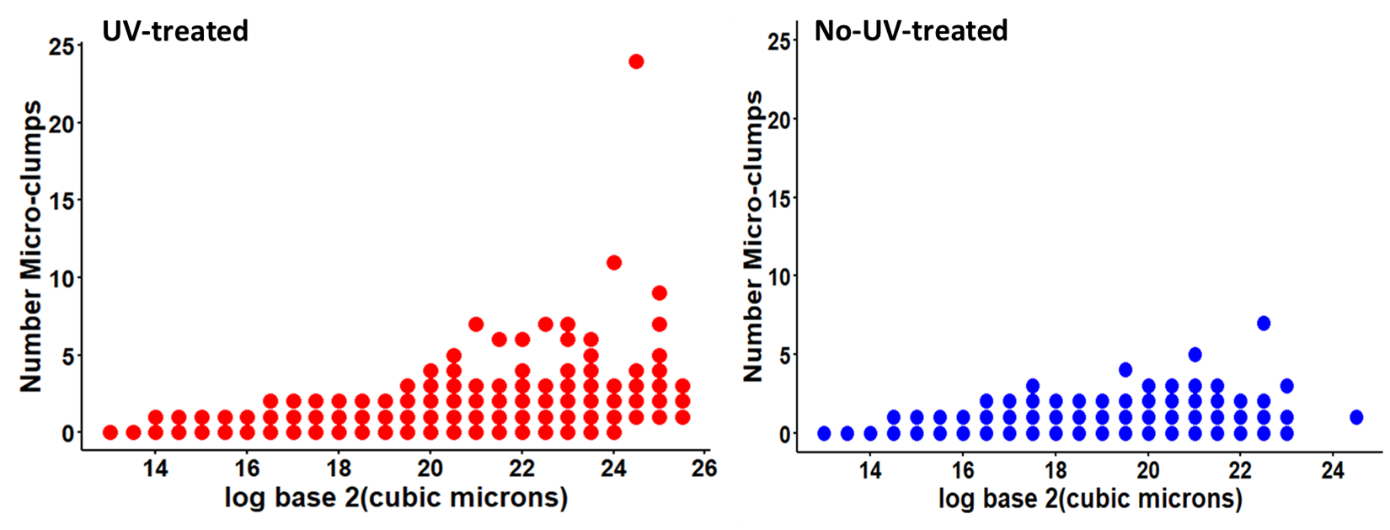

Slide 5


UV-treated
No-UV-treated

Slide 6
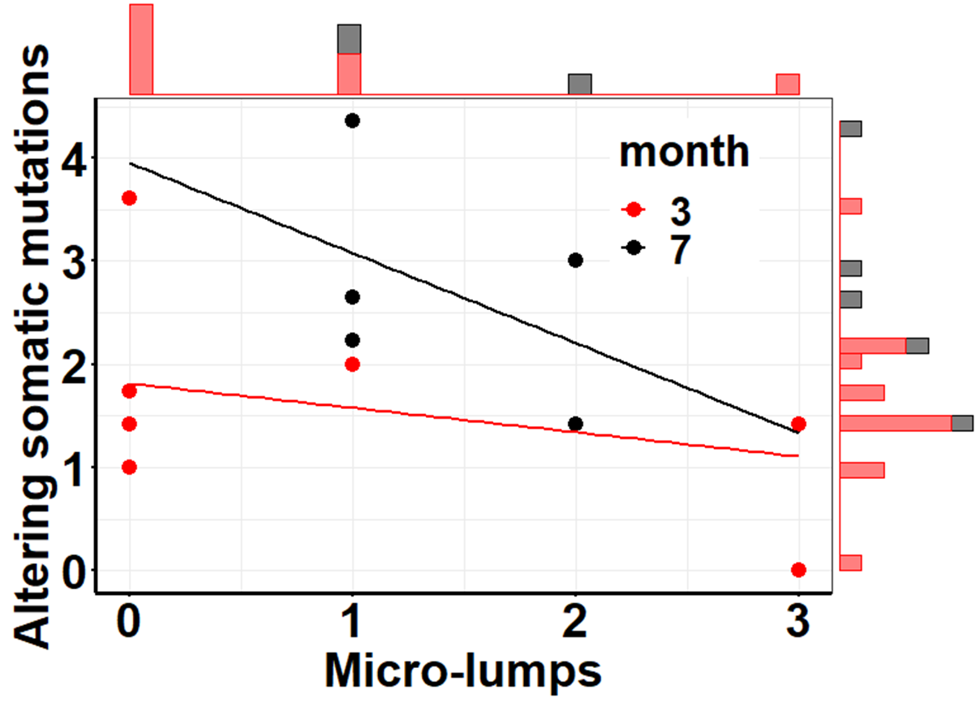
No-UV-treated

Slide 7
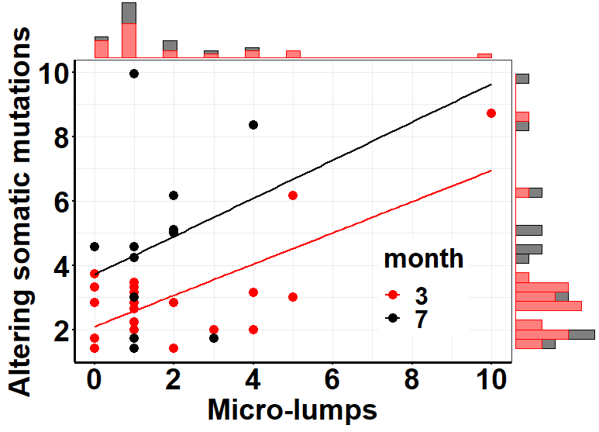
UV-treated

Slide 8
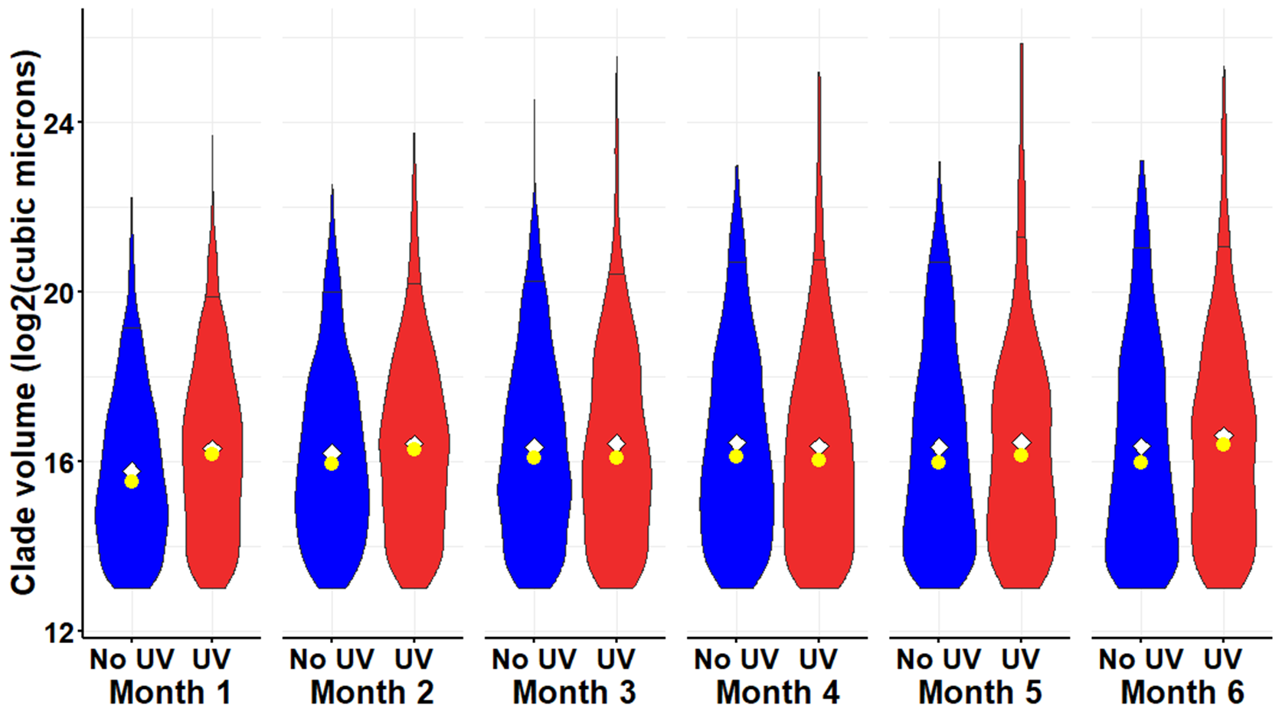
This is with corrected data

Slide 9

This is with corrected data

Slide 10
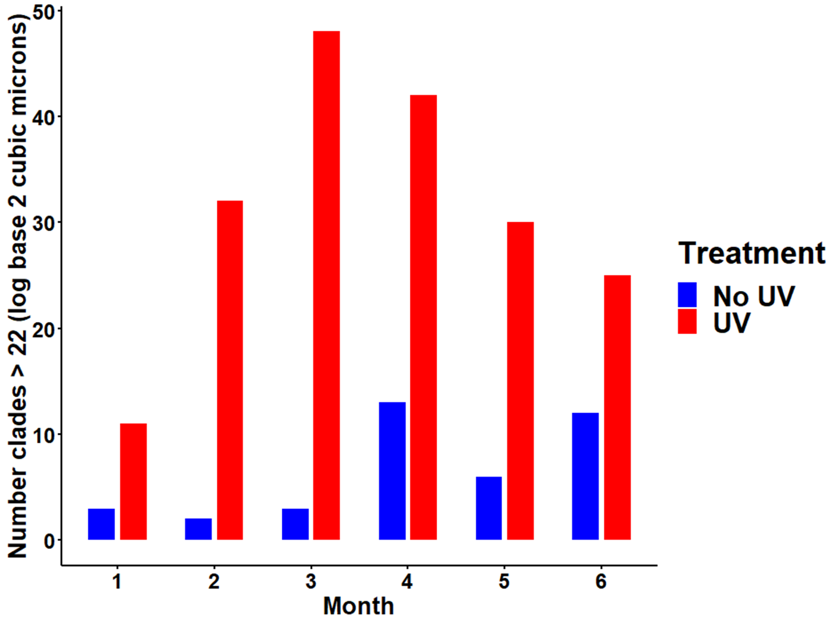
This is with corrected data

Slide 11
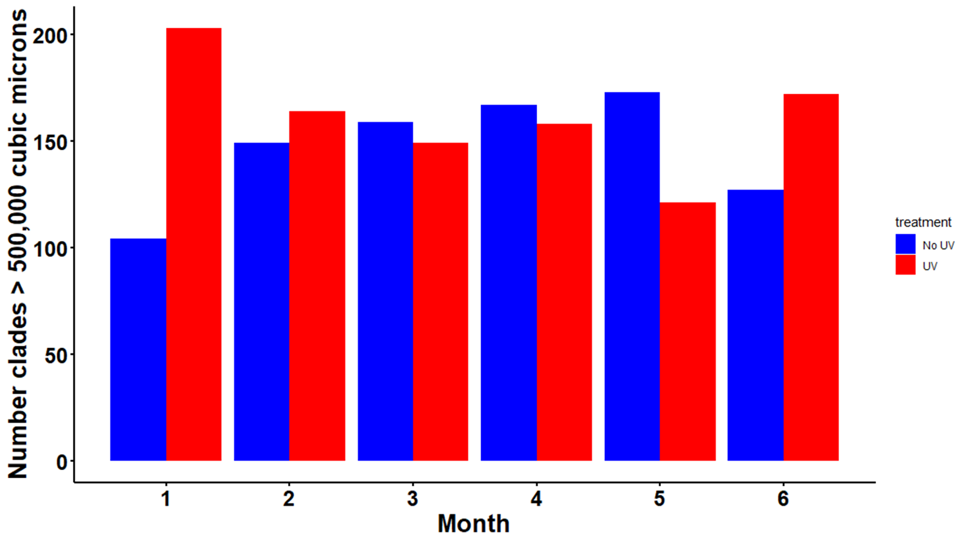

Slide 12
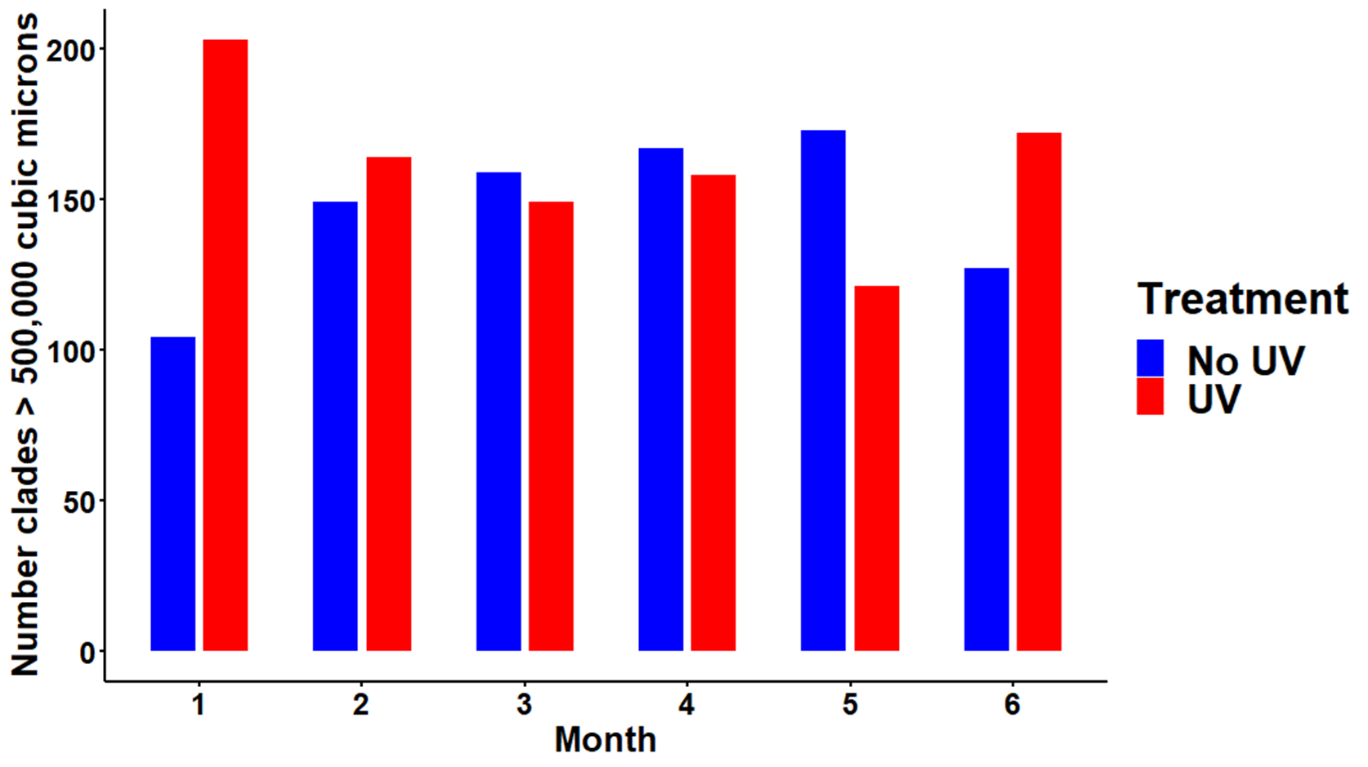

Slide 13
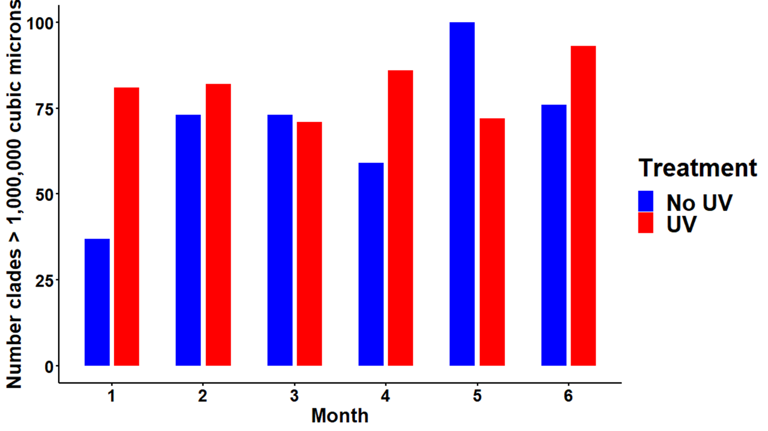
Big goliaths > 1,000,000 cubic microns

Slide 14
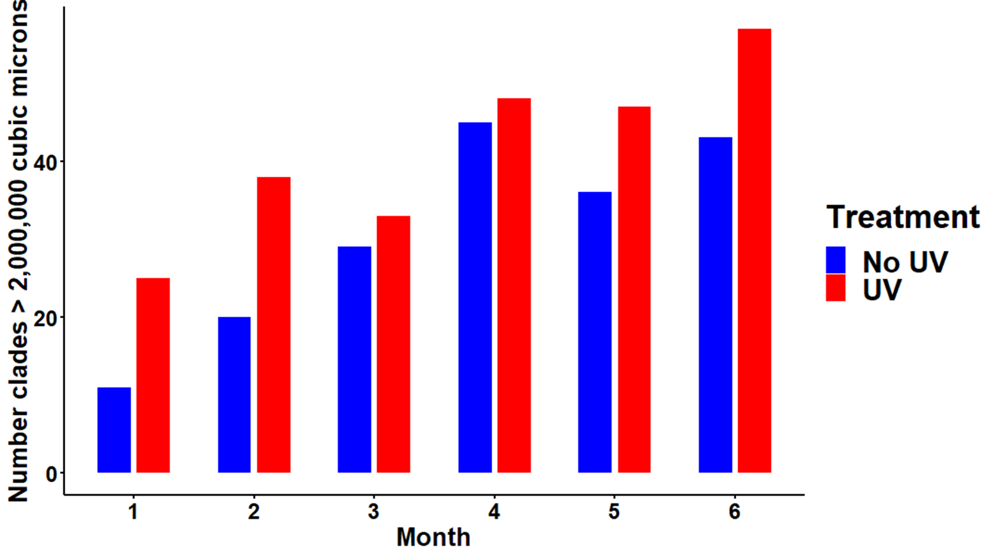
Really Big goliaths > 2,000,000 cubic microns

Slide 15
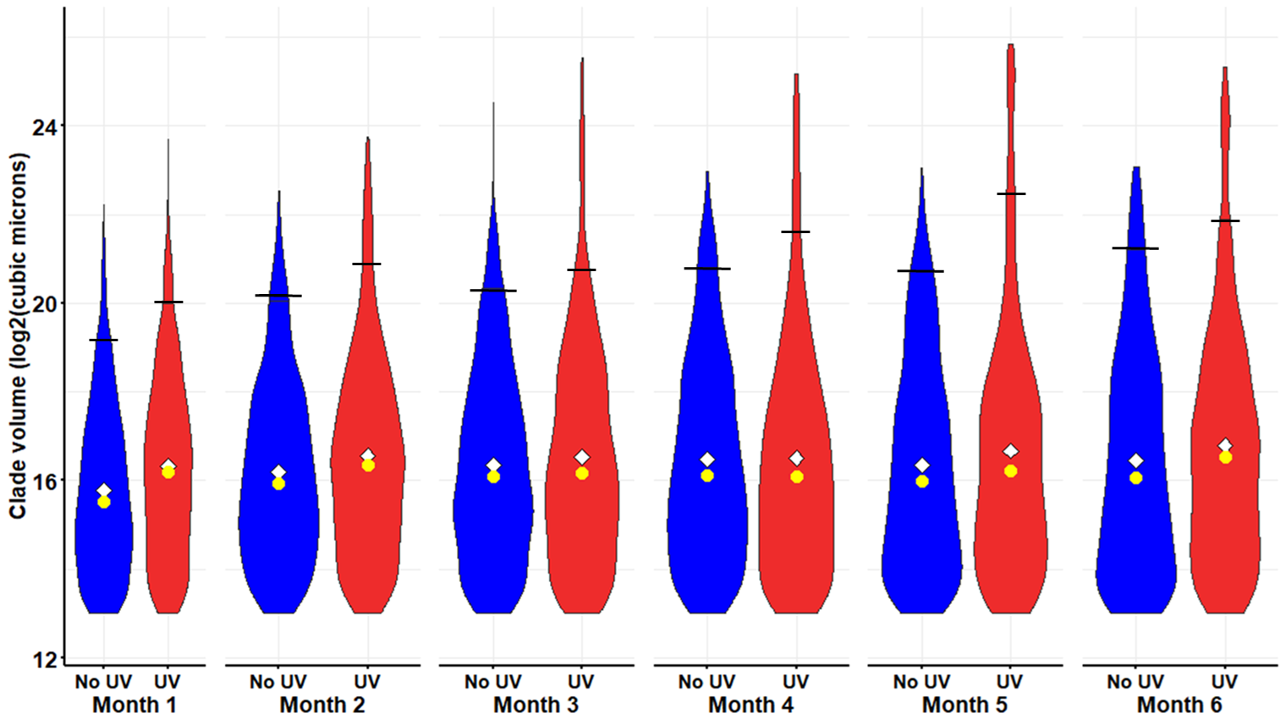
All the following are with the uncorrected data

Slide 16
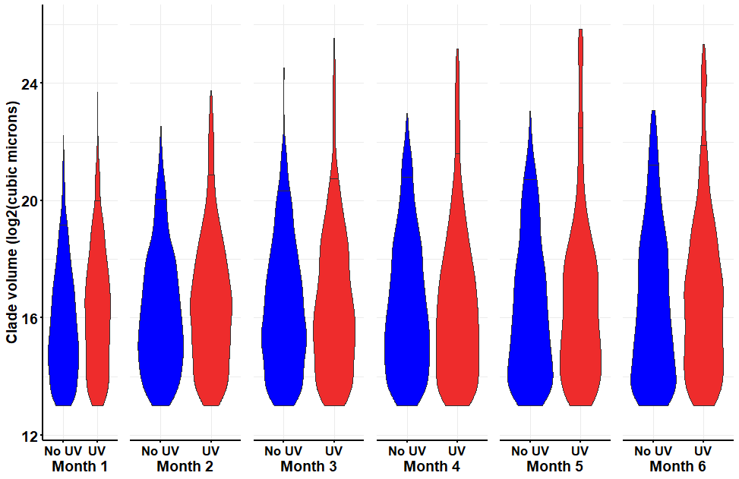
This is the original figure on which I added the horizontal lines at the 95% quantile.
The figure on next slide combines all elements and saves as .png format.

Slide 17

This is the original figure on which I added the horizontal lines at the 95% quantile.
The figure on the first slide combines all elements and saves as .png format.

Slide 18


Slide 19
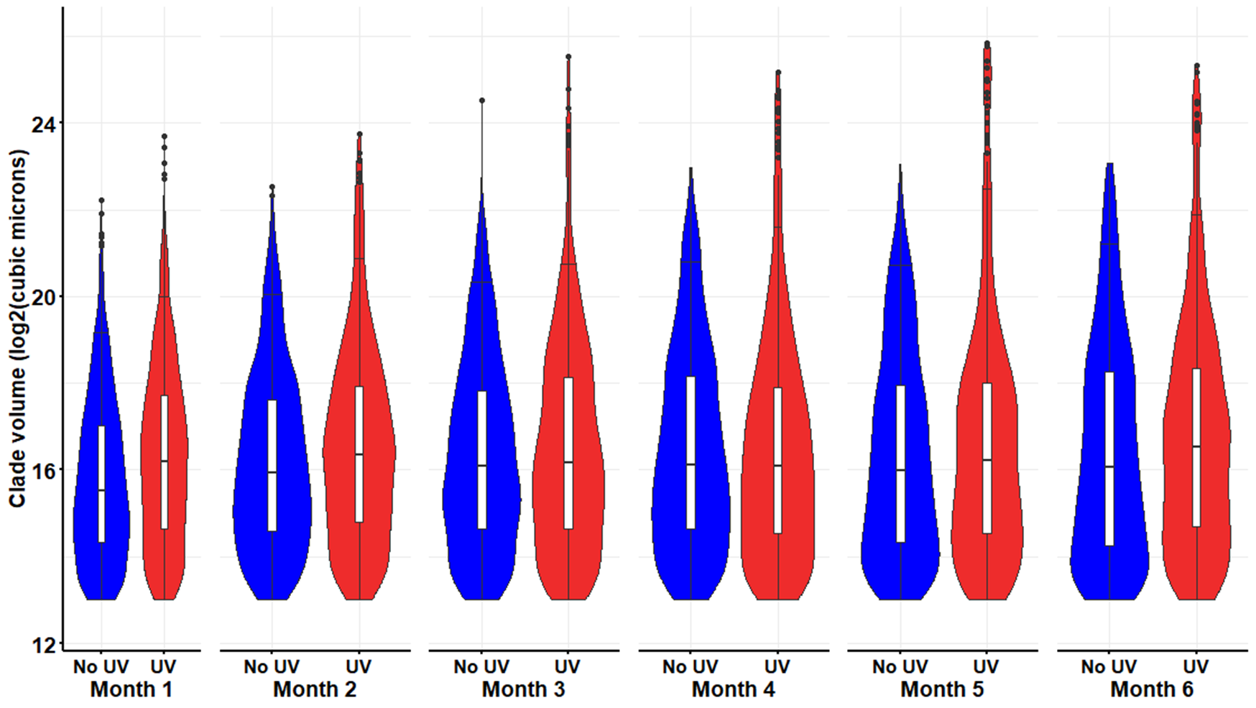

Slide 20
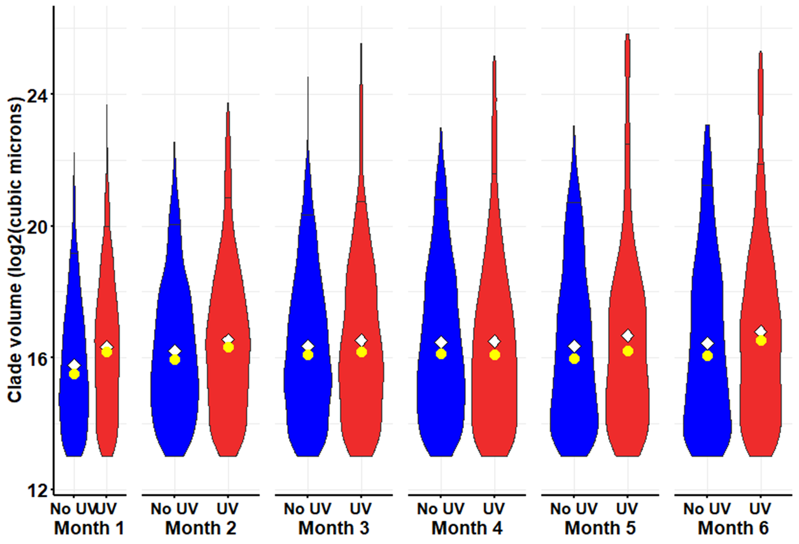

Slide 21


Slide 22
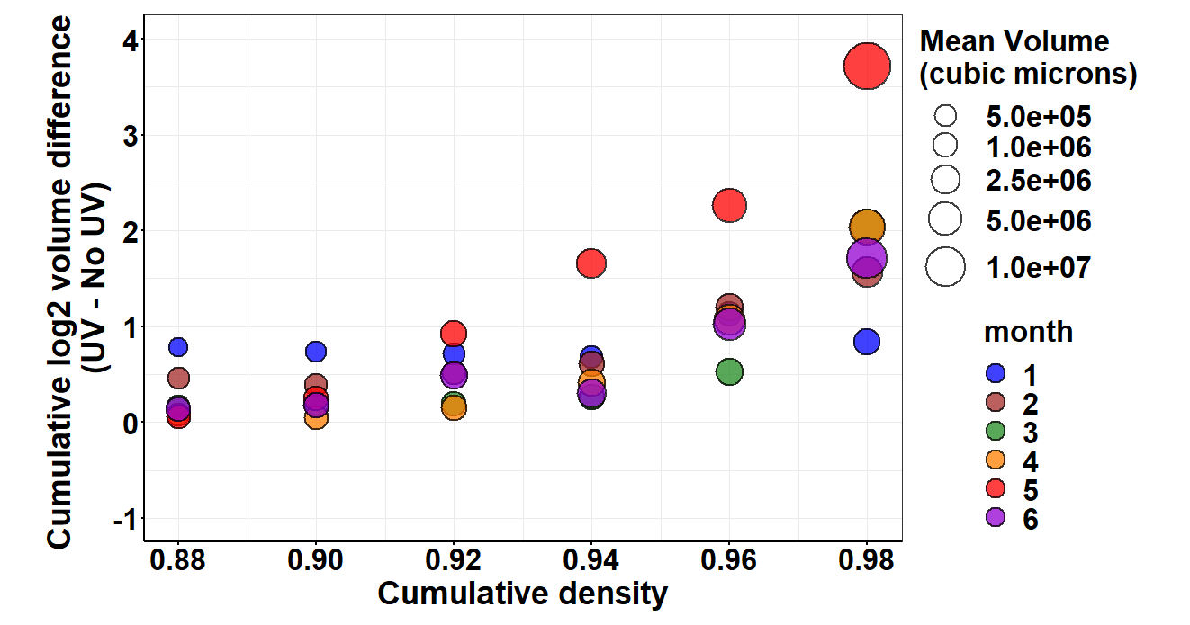

Slide 23
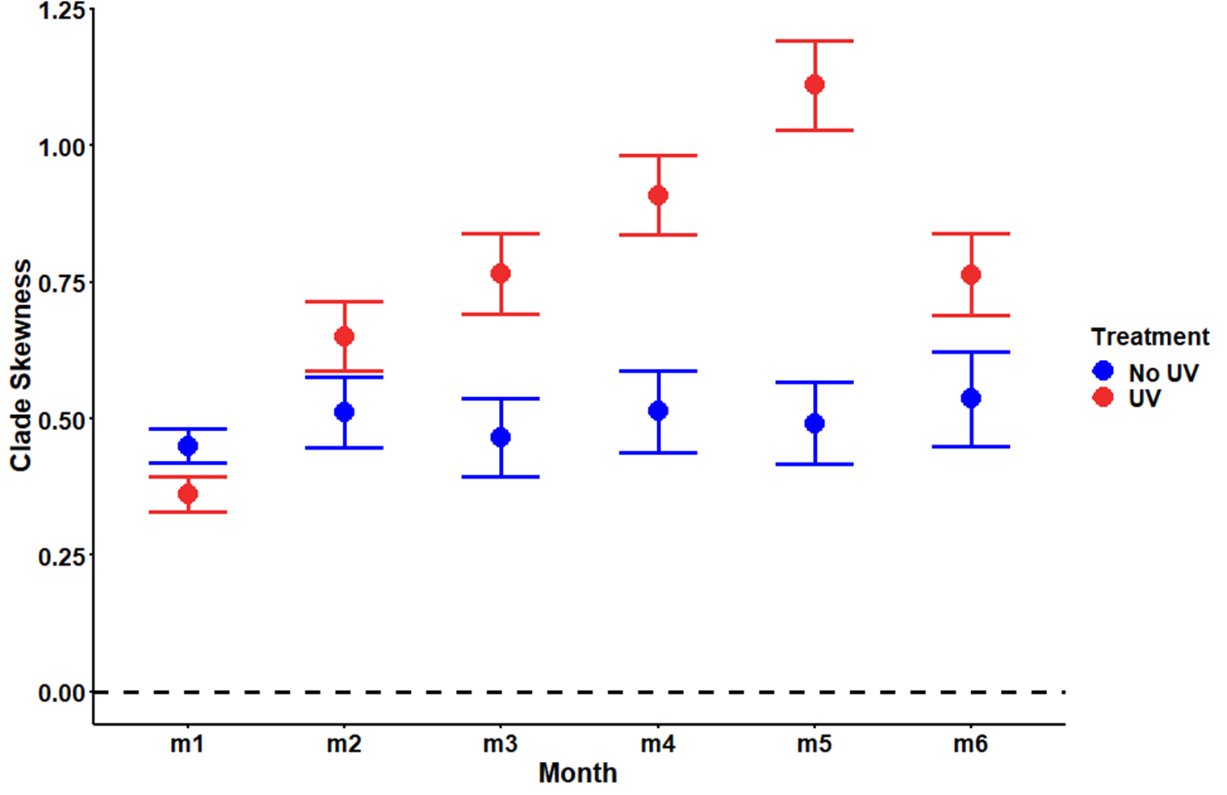

Slide 24
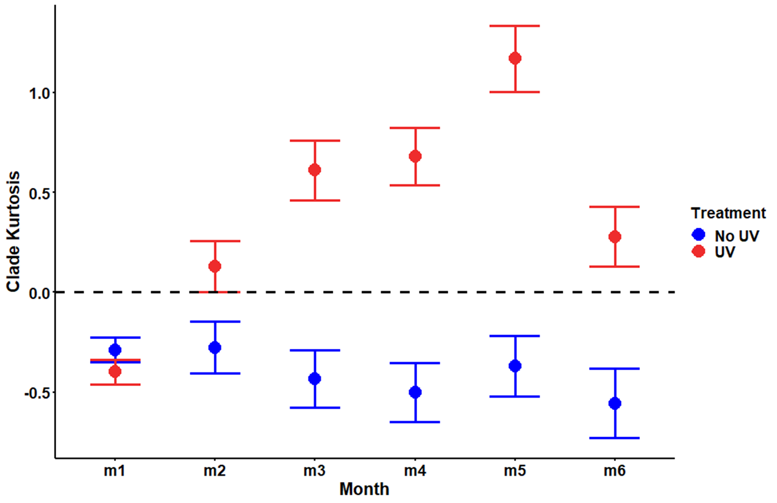

Slide 25




A
B
C
D

Slide 26
